Slide 1
Search, Part 4 Lecture 7 Chapter 3, Sections 3.5-3.6
Jim Rehg
College of Computing
Georgia Tech
January 29, 2016

Slide 2

Where Was Prof. Rehg last Wed?
NSF I-Corps Kick-Off Meeting (Houston, TX)
Program to explore commercialization opportunities for research technology
Participating with Agata Rozga (Res. Scientist), Yin Li (PhD student), and Ernesto Escobar (Mentor)
$50K to conduct interviews and purse customer discovery

Slide 3
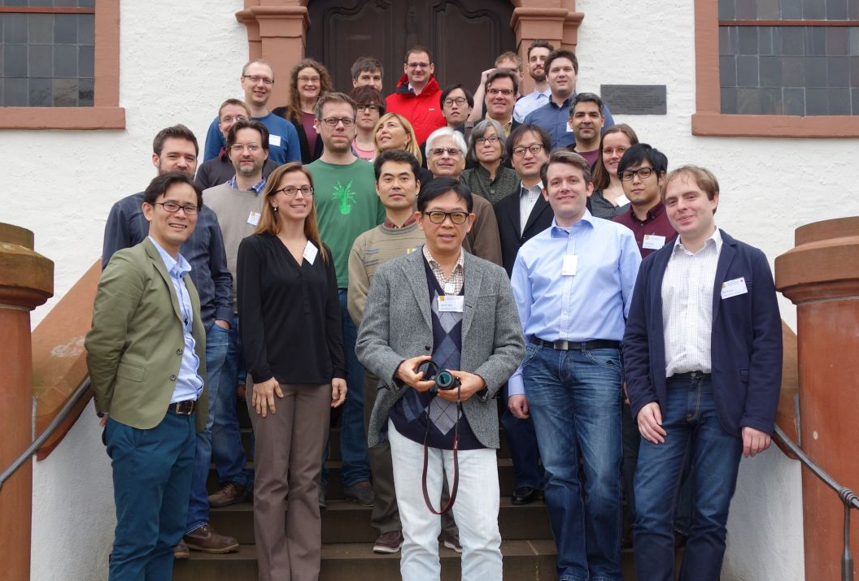
Where Was Prof. Rehg on Mon and Wed?
Dagstuhl Seminar 16042
Eyewear Computing – Augmenting the Human with Head-Mounted Wearable Assistants
Well-known international forum for exchange of research ideas
I was co-organizer with researchers from Germany, Japan, and Google (CA)
Focus on “wearable cameras meet HCI”

Slide 4
A* Search – Additional Details
Identify the relationship between
A* Search
Greedy Best-First Search
Uniform Cost Search

Slide 5
A* Search – Additional Details
Identify the relationship between
A* Search – Optimal heuristic search
Greedy Best-First Search – Greedy search with “wrong” cost
Uniform Cost Search – Basic cost-based search method, basis for A* when using optimal heuristic

Slide 6



Problem with Best-First Greedy Search
4
A
A
2
B
1
C
1
D
2
E
2
$$f=3$$
B
h=4
h=3
h=2
h=1
h=0
1
4
$$f=2$$
C
D
$$f=1$$
2
Best-First doesn’t keep track of cost along path, and takes a high cost arc to a low cost state
E
Cost = 8
Notes:
Example due to Andrew Moore

Slide 7






Problem with Best-First Greedy Search
4
A
A
2
B
1
C
1
D
2
E
2
$$f=5$$
$$f=3$$
B
h=4
h=3
h=2
h=1
h=0
1
4
$$f=5$$
$$f=7$$
$$f=2$$
C
D
$$f=1$$
A* uses path cost + heuristic, correctly chooses the lower
cost path
1
2
$$f=4+1=5$$
D
E
2
Cost = 8
Cost = 6
E
Notes:
Example due to Andrew Moore

Slide 8




When Should A* Terminate?
S
1
B
S
1
1
1
1
h=8
h=3
C
A
1
$$f=8$$
A
B
$$f=4$$
7
D
7
h=2
1
h=7
G
h=1
Frontier (Queue)
S(8)
B(4) A(8)
C(4) A(8)
D(4) A(8)
C
$$f=4$$
h=0
1
D
$$f=4$$
Expanding D gives goal node, but terminating at this point gives suboptimal solution
7
G

Slide 9


When Should A* Terminate?
S
1
B
S
1
1
1
1
h=8
h=3
C
A
1
$$f=8$$
A
B
$$f=4$$
7
D
7
h=2
7
1
h=7
G
h=1
Frontier (Queue)
S(8)
B(4) A(8)
C(4) A(8)
D(4) A(8)
A(8) G(10)
G(8) G(10)
G
C
$$f=8$$
$$f=4$$
h=0
1
D
$$f=4$$
Push goal node on queue,
expanding A leads to optimal path to goal
7
G
$$f=10$$
Notes:
Example credit: Andrew Moore
Note: G(10) is crossed out because we will remove the duplicate node with higher cost since it will never be selected

Slide 10
When Should A* Terminate?
S
1
B
S
1
1
1
1
h=8
h=3
C
A
1
$$f=8$$
A
B
$$f=4$$
7
D
7
h=2
7
1
h=7
G
h=1
Frontier (Queue)
S(8)
B(4) A(8)
C(4) A(8)
D(4) A(8)
A(8) G(10)
G(8)
G
C
$$f=8$$
$$f=4$$
h=0
1
D
$$f=4$$
Answer: Terminate when goal node is popped from queue
7
G
$$f=10$$
Notes:
Example credit: Andrew Moore

Slide 11





When Does A* Revisit States?
S
1
B
S
1
1
1
1
h=8
h=3
C
A
$$f=8$$
A
B
$$f=4$$
0.5
D
1
h=2
h=7
Frontier (Queue)
S(8)
B(4) A(8)
C(4) A(8)
D(4) A(8)
A(8) G(10)
1
G
7
h=1
C
$$f=4$$
h=0
1
D
$$f=4$$
7
G
$$f=10$$
Notes:
Example credit: Andrew Moore

Slide 12

When Does A* Revisit States?
S
1
B
S
1
1
1
1
h=8
h=3
C
A
$$f=8$$
A
B
$$f=4$$
0.5
D
1
h=2
h=7
Frontier (Queue)
S(8)
B(4) A(8)
C(4) A(8)
D(4) A(8)
A(8) G(10)
C(3.5) G(10)
0.5
1
G
7
h=1
C
C
$$f=3.5$$
$$f=4$$
h=0
1
C visited on path S-B-C, added to visited list, and then re-visited on S-A-C at lower cost
D
$$f=4$$
7
G
$$f=10$$
Notes:
Example credit: Andrew Moore

Slide 13


When Does A* Revisit States?
S
1
B
S
1
1
1
1
h=8
h=3
C
A
$$f=8$$
A
B
$$f=4$$
0.5
D
1
h=2
h=7
Frontier (Queue)
S(8)
B(4) A(8)
C(4) A(8)
D(4) A(8)
A(8) G(10)
C(3.5) G(10)
D(3.5) G(10)
G(9.5)
0.5
1
G
7
h=1
C
C
$$f=3.5$$
$$f=4$$
h=0
1
1
$$f=3.5$$
D
D
$$f=4$$
States on closed list can be revisited at a lower cost
7
7
$$f=9.5$$
G
G
$$f=10$$
Notes:
Example credit: Andrew Moore

Slide 14
Visited List
S
Visited (Closed List)
(S, 8, null)
(B, 4, S)
(C, 4, B)
(D, 4, C)
(A, 8, S)
Frontier (Queue)
S(8)
B(4) A(8)
C(4) A(8)
D(4) A(8)
A(8) G(10)
C(3.5) G(10)
1
1
$$f=8$$
A
B
$$f=4$$
0.5
1
$$f=3.5$$
C
C
$$f=4$$
1
Maintain visited list for expanded nodes: (state, cost, backpointer)
D
$$f=4$$
7
Will allow us to recover solution once we reach goal
G
$$f=10$$
Notes:
Example credit: Andrew Moore

Slide 15
Visited List
S
Visited (Closed List)
(S, 8, null)
(B, 4, S)
(C, 4, B)
(D, 4, C)
(A, 8, S)
(C, 3.5, A)
Frontier (Queue)
S(8)
B(4) A(8)
C(4) A(8)
D(4) A(8)
A(8) G(10)
C(3.5) G(10)
1
1
$$f=8$$
A
B
$$f=4$$
0.5
1
$$f=3.5$$
C
C
$$f=4$$
1
States that are revisited with lower cost replace previously-added nodes
D
$$f=4$$
7
Maintain visited list, add expanded nodes: (state, cost, backpointer)
G
$$f=10$$
Notes:
Example credit: Andrew Moore

Slide 16
Visited List
S
Visited (Closed List)
(S, 8, null)
(B, 4, S)
(C, 4, B)
(D, 4, C)
(A, 8, S)
(C, 3.5, A)
(D, 3.5, C)
(G, 9.5, D)
Frontier (Queue)
S(8)
B(4) A(8)
C(4) A(8)
D(4) A(8)
A(8) G(10)
C(3.5) G(10)
D(3.5) G(10)
G(9.5)
1
1
$$f=8$$
A
B
$$f=4$$
0.5
1
$$f=3.5$$
C
C
$$f=4$$
1
1
$$f=3.5$$
D
D
$$f=4$$
Backchain to retrieve state sequence: G, D, C, A, S and reverse it to obtain action plan
7
7
$$f=9.5$$
G
G
$$f=10$$
Notes:
Example credit: Andrew Moore

Slide 17


When Does A* Revisit States?
S
1
B
S
1
1
1
1
h=8
h=3
C
A
$$f=8$$
A
B
$$f=4$$
0.5
D
1
h=8
h=7
Frontier (Queue)
S(8)
B(4) A(8)
A(8) C(10)
C(9.5) C(10)
0.5
1
G
7
h=1
C
C
$$f=9.5$$
$$f=10$$
h=0
With change in heuristic, state C is promoted with a lower cost after being added to queue initially
S-A-C (9.5) vs. S-B-C(10)
To avoid confusion, you can always write the path explicitly when adding node to queue
Notes:
Example credit: Andrew Moore

Slide 18
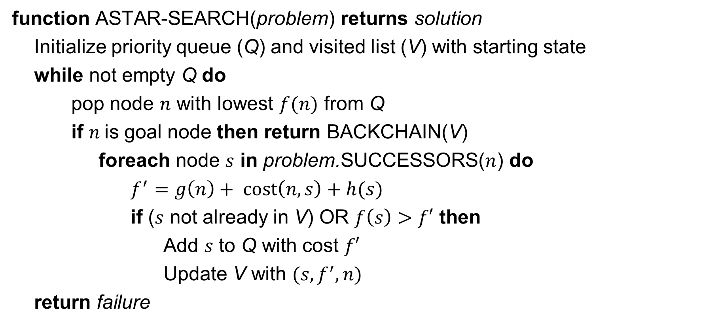
Pseudocode for A* Search
function ASTAR-SEARCH(problem) returns solution
Initialize priority queue (Q) and visited list (V) with starting state
while not empty Q do
pop node $n$ with lowest $f(n)$ from Q
if $n$is goal node then return BACKCHAIN(V)
foreach node $s$ in problem.SUCCESSORS($n$) do
$f^{′}=g\left(n\right)+ \text{cost}\left(n,s\right)+h(s)$
if ($s$ not already in V) OR $f\left(s\right)>f′$ then
Add $s$ to Q with cost $f′$
Update V with $(s,f^{′},n)$
return failure
Notes:
Note for successor node s reached from node n we have g(s) = g(n) + cost(n,s), where cost(n,s) gives the cost of the edge connecting n to s
h(n) is the heuristic estimate of cost to goal for each node n
g(n) is the cost of the shortest known path to node n from start
In the test for adding a new node s to Q, the condition f(s)>f’ means that the previous cost f(s) associated with s in V is greater than the new cost f’ for s along the current path.

Slide 19
8-Puzzle Example
Which of the following are admissible heuristics?
1) h(n) = Number of tiles in wrong position in state n
2) h(n) = 0
3) h(n) = Sum of Manhattan distances between each tile and its goal location
4) h(n) = 1
5) h(n) = min(2, h*(n))
6) h(n) = h*(n)
7) h(n) = max(2, h*(n))
Example State
Goal State
4
2
7
1
2
3
6
5
4
5
6
1
8
3
7
8

Slide 20
8-Puzzle Example
Which of the following are admissible heuristics?
1) h(n) = Number of tiles in wrong position in state n YES
2) h(n) = 0 YES
3) h(n) = Sum of Manhattan distances between each tile and its goal location YES
4) h(n) = 1 NO
5) h(n) = min(2, h*(n)) YES
6) h(n) = h*(n) YES
7) h(n) = max(2, h*(n)) NO
Example State
Goal State
4
2
7
1
2
3
6
5
4
5
6
1
8
3
7
8
Notes:
Note that h*(n) is the true cost to the goal from node n along the shortest path
If tiles could be instantly transported to their correct location with a cost of 1, then the number of tiles in wrong position is an under-estimate of the total distance the tiles need to be moved
0 is always an under-estimate of all positive distances
The Manhattan distance is the number of moves each tile needs to make without accounting for constraints on their movement due to other tiles, therefore it is an under-estimate
For the goal state g we have h*(g)=0 < h(g)=1 which violates the condition of admissibility. Thus, given a state s which is one move away from the goal, the heuristic says that the goal is two moves away. What about consistency? The formal definition requires h(g)=0, so the heuristic is also inconsistent. What would the behavior of A* be using this heuristic? For all of the states s which are one move away from the goal, the heuristic will prevent the goal state from being automatically selected over other adjacent nongoal states. However, as long as a closed list is used, eventually all other states adjacent to s will be visited, and a goal state will eventually be expanded. Will the solution still be optimal? Yes, the heuristic in this case is non-informative, so A* will always expand along the shortest path at every step. Therefore the solution at the shallowest depth will be found first.
This heuristic will be an under-estimate whenever h*(n)>2 and will be equal to h*(n) otherwise
The requirement is h(n) <= h*(n) so equality is clearly allowed
The heuristic will over-estimate whenever h*(n) < 2

Slide 21
Dominance
Reminder: Heuristic h(n) is admissible if h(n) <= h*(n)
If h1 and h2 admissible heuristics, and
h2(n) >= h1(n) for all n,
Then h2 dominates h1, and
h2 is better for search
Why?
Note: h’(n) = max{ h1(n), h2(n) } is admissible and dominates h1 and h2

Slide 22
Dominant Heuristic is Better
In A* every node n with
f(n) < C* will be expanded
h(n) < C* – g(n) will be expanded
h2(n) > h1(n) for all n, then
Set of n for which h1(n) < C* – g(n)
Will be larger than set of n for which h2(n) < C* – g(n)
Thus h1 will expand more nodes

Slide 23
Questions?

